Slide 1
Manual Testing
Type of Testing :
Functional Testing
Function, Integration, System, Regression, Ad-hoc, Exploratory, Smoke, Sanity
Life Cycle :
SDLC, STLC, DLM ,ATLC
Techniques of Testing :
Equivalence Partitioning Testing Technique
Boundary Value Analysis Testing Technique
Testing Approaches, Test Strategy, Test Plan

Slide 2
Type Of Testing
Functional Testing | Non-Functional Testing
Test System against the client requirement using functional specification | Test System like performance , reliability
Use Manual or automation tools | Use tools will be effective
Execute before Non-functional Testing | Execute after Functional Testing
Testing inputs Business requirement | Testing inputs performance parameter like speed , scalability

Slide 3
Functional Testing
Test the functionality of application by providing certain input
Part of Functional Testing :
Understand Requirements clearing the doubts and queries using review comment
Writing test cases against the requirements
Identified test inputs to execute test cases
Determine the actual outcome as per input value
Execute testcase and compare actual result VS actual outcome
Integration Testing
It is a level of software testing where individual units are combined and tested as a grouped
Why Integration
In the real world, when applications are developed, it is broken down into smaller modules
and individual developers are assigned 1 module. The logic implemented by one developer is
quite different than another developer, so it becomes important to check whether the logic
implemented by a developer is as per the expectations
Frequent requirement change! Many a time developer deploys the changes without
unit testing it

Slide 4
System Testing
It is a level of testing that validates the complete and fully integrated software product.
How to Test :
Verify thorough testing of every input in the application to check for desired outputs.
Testing of the user's experience with the application.
System testing done by a professional testing agent on the completed software product before
it is introduced to the market.
Regression Testing
It is Nothing but a full or partial selection of already executed test cases which are re-executed to ensure existing functionalities work fine. OR
verify that a code change in the software does not impact the existing functionality of the product. This is to make sure the product works fine with new functionality, bug fixes or any change in the existing feature

Slide 5
Ad-hoc Testing
Informal and unplanned activity,
Main aim of this testing is to find defects by random checking
Ad hoc testing can be performed when there is limited time to do elaborative testing.
defects will not be mapped to test cases. This means that, sometimes, it is very difficult to reproduce the
defects as there are no test steps or requirements mapped to it.
Exploratory Testing
Is a type of software testing where Test cases are not created in advance, but testers check system on the fly.
In this testing test planning, analysis, design and test execution,
are all done together and instantly.

Slide 6
Smoke Testing
Testing done when
Initial Build when build is not stable ,
Test main functionality not deep if working then regression or functional testing can do
Sanity Testing
Testing done when
At the end of build is stable,
verify bug and new feature if working then regression or functional testing can do

Slide 7
Non-functional Testing
It is defined as a type of Software testing to check below non-functional aspects
Security : The parameter defines how a system is safe against sudden attacks from internal and external sources
Reliability: Software system continuously performs the specified functions without failure.
Availability: Stability Testing is done to check the efficiency of a developed product beyond normal operational capacity
Usability : Easy to handle or operate by user
Flexibility : Can work in different hardware and software configuration
Endurance Testing

Slide 8
Life Cycle
Software Development Life Cycle
Requirement Analysis
stockholder and domain expert
Feasibility Study
Prepare SRS document
Design
Coding
Testing
Deployment
Maintains

Slide 9
Defect Life Cycle
New-Assign-Open-Fixed-Retest-Close
New-Assign-Open-Reject: Duplicate/nonvalid
New-Assign-Open-Fixed-Retest-Reopen

Slide 10
Software Testing Life Cycle
Requirement Analysis
Test Planning
Test Team plans the strategy and approach.
Test Case Development
Develop the test cases based on scope and criteria.
Environment Setup
define what kind of testing environment needed for testing like device testing or etc.
Test Case Execution
Real-time validation of product and finding bugs
Test Case Closer
Once testing is completed, matrix, reports, results are documented

Slide 11
Automation Testing Life Cycle
Phase 1
Determining The Scope Of Test Automation
Which modules of the applications can be automated and which not?
Which test can be automated and how to automate them?
Factors like cost, team size and expertise should also be considered.
Phase 2
Selecting The Right Tool For Automation parameters when selecting tool
Budget , Technology , flexibility
Phase 3
Test Plan + Test Design + Test Strategy
Gather all manual test cases from the test management tool to identify which test case needs to be automated.
Identify Framework
Phase 4
Setting Up The Test Environment
Setting up a machine or remote machine where test cases will be executed
Phase 5
Automation Test Script Development + Execution
Ensure to run test scripts in multiple environments and across multiple platforms.
If possible, batch execution can be done to save time and efforts.
If the failure occurs due to some functionality, write a bug report
Phase 6
Analysis + Generation Of Test Reports

Slide 12
Testing Approach
Proactive - An approach in which the test design process is initiated as early as possible in order to find and fix the defects before the build is created.
Reactive - An approach in which the testing is not started until after design and coding are completed.
Integration Testing Approaches
Big-Bang Approach :
When all component are integrated together then test as unit.
If all components in unit are not completed integration process will not execute.
Incremental Approach:
Top-Down Approach
Bottom-up Approach
Hybrid Approach

Slide 13
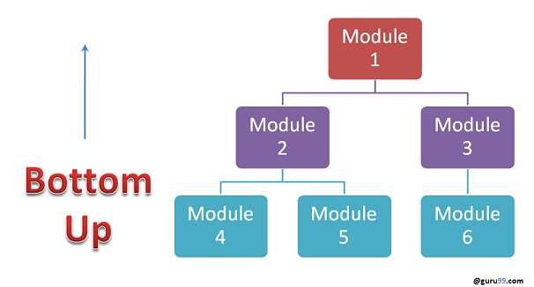
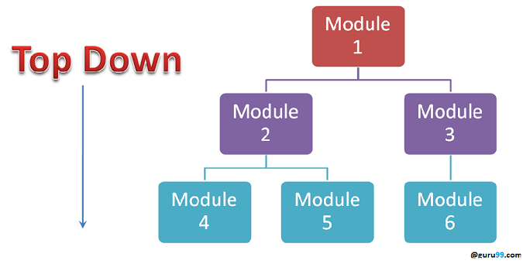
Integration Incremental Testing Approach
Stub: Is called by the Module under Test.
Driver: Calls the Module to be tested.

Slide 14
Test Strategy
Scope and Objective : objective of business and how much testing scope there define under test strategy.
Business Issue : define budget of project, time and resources it is part of business issue.
Testing Approach : define what type of testing needed like manual or automation.
Tools Approach : define tool for tracking the defects.
Test Plan
Test Environment : define what kind of testing environment needed for testing like device testing or etc.
Feature Testing : define which type of feature testing needed and which type of feature not testing.
Entry and Exit Criteria : Define when start and stop testing.

Slide 15
Techniques of Testing
Equivalence Partitioning Testing
If you are testing for an input box accepting numbers from 1 to 1000 then there is no use in writing thousand test cases for all 1000 valid input numbers plus other test cases for invalid data.
Using the Equivalence Partitioning method above test cases can be divided into three sets of input data called classes. Each test case is representative of a respective class.
1) One input data class with all valid inputs. Pick a single value from range 1 to 1000 as a valid test case. If you select other values between 1 and 1000 the result is going to be the same. So one test case for valid input data should be sufficient.
2) Input data class with all values below the lower limit. I.e. any value below 1, as an invalid input data test case.
3) Input data with any value greater than 1000 to represent the third invalid input class.

Slide 16
Boundary Value Testing
Consider the above Example
1) Test cases with test data exactly as the input boundaries of input domain i.e. values 1 and 1000 in our case.
2) Test data with values just below the extreme edges of input domains i.e. values 0 and 999.
3) Test data with values just above the extreme edges of the input domain i.e. values 2 and 1001.
Boundary Value Analysis is often called as a part of the Stress and Negative Testing.

